Slide 1
Laboratory Safety modified from http://www.sterlingschools.org/shs/stf/cbrown/Chemistry%20Laboratory%20Safety%20Rules.ppt

Slide 2
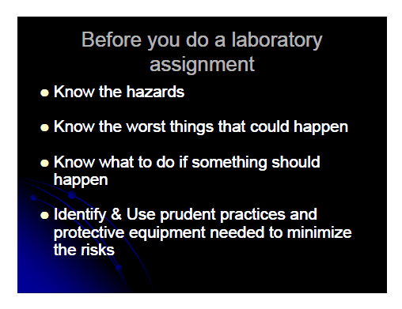

Slide 3
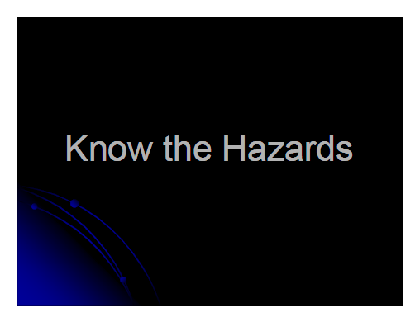

Slide 4
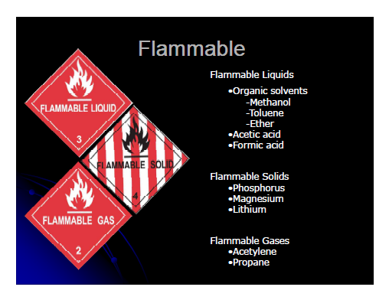

Slide 5
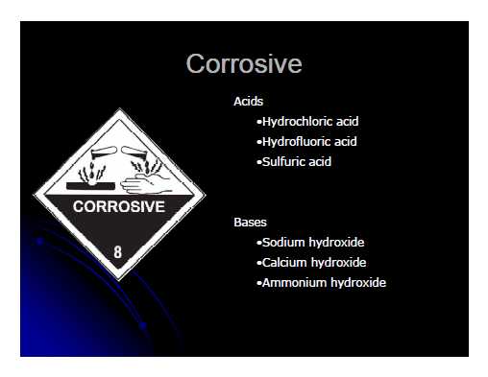

Slide 6
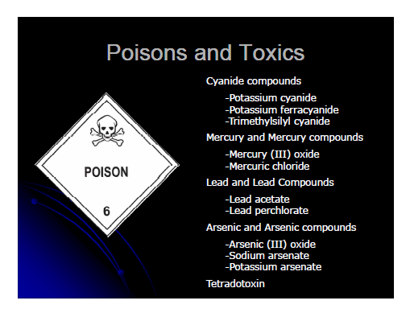

Slide 7
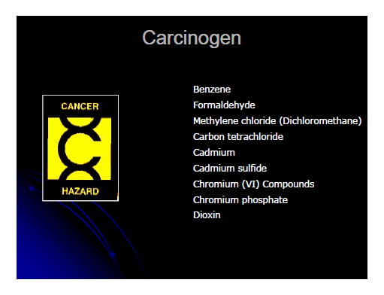

Slide 8
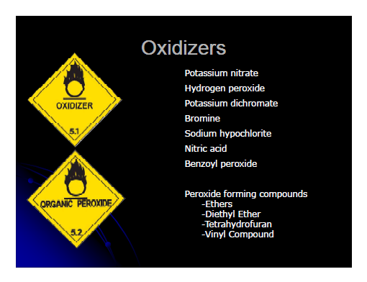

Slide 9
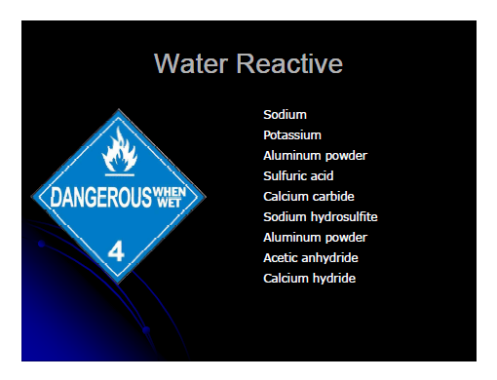

Slide 10
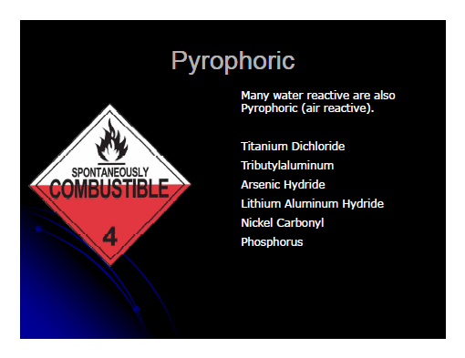

Slide 11
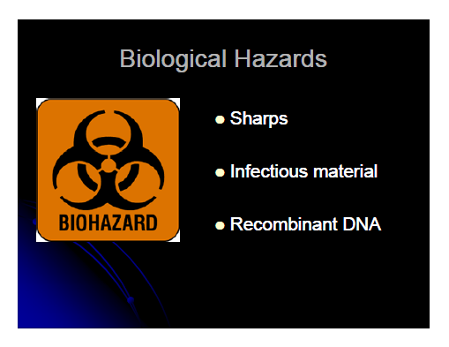

Slide 12
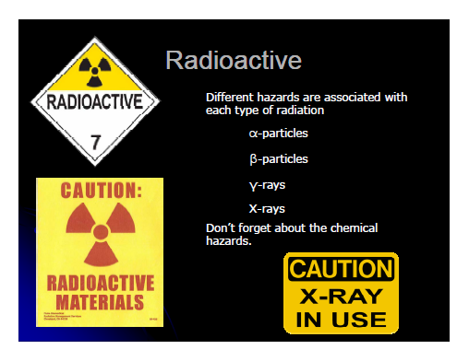

Slide 13
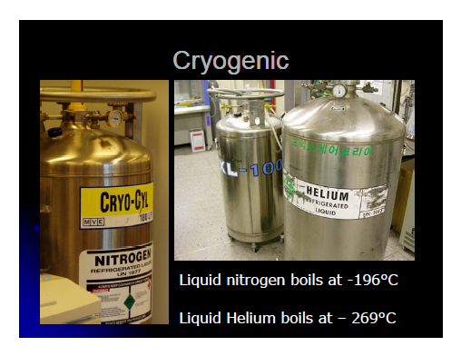

Slide 14
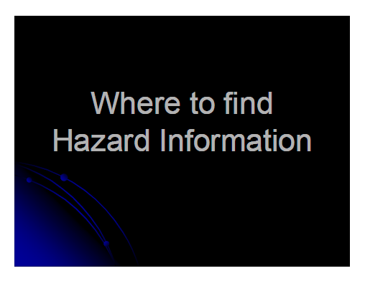

Slide 15
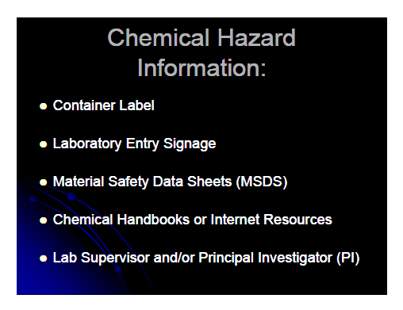

Slide 16
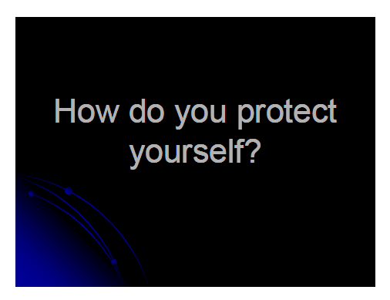

Slide 17
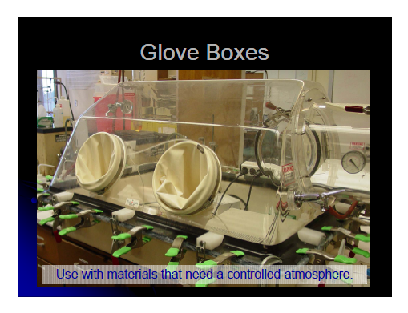

Slide 18
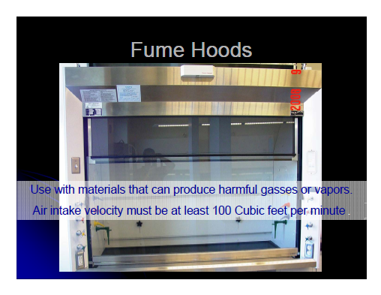

Slide 19
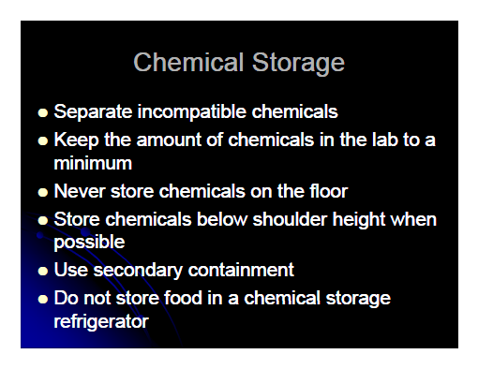

Slide 20
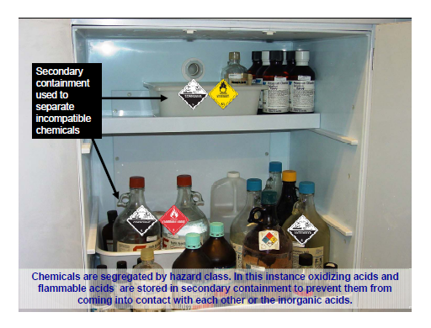

Slide 21
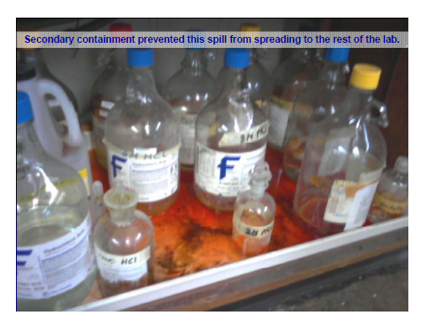

Slide 22


Slide 23
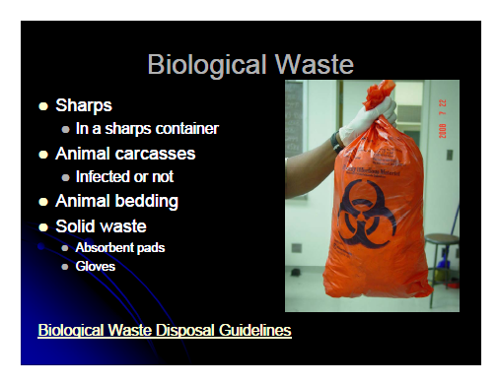

Slide 24
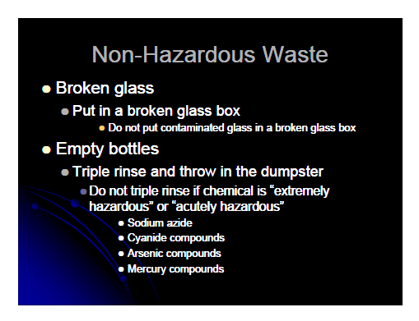

Slide 25
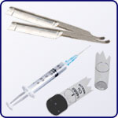
Sharps Safety http://web.mit.edu/cohengroup/safety/sharps.pdf
Sharps containers have to be:
Puncture Resistant
Clearly marked
Within easy reach of the work station
Filled to no more than 3/4 capacity
Sealed (i.e. capped or taped) prior to transport

Slide 26
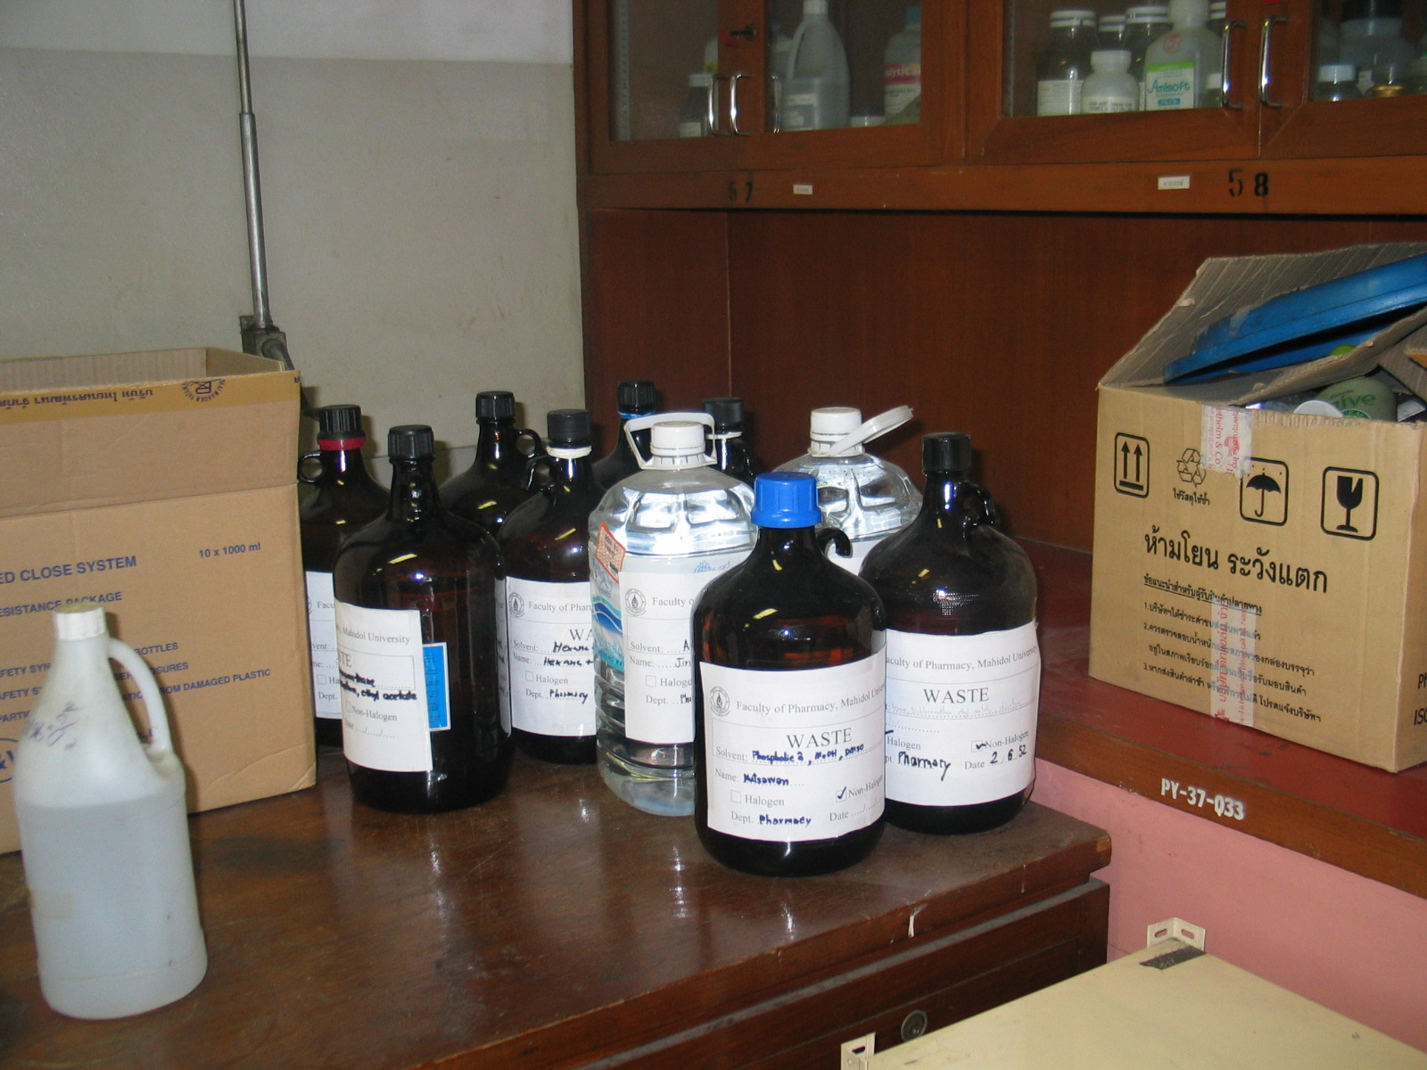
WASTE - Label
Notes:
Waste - Label

Slide 27
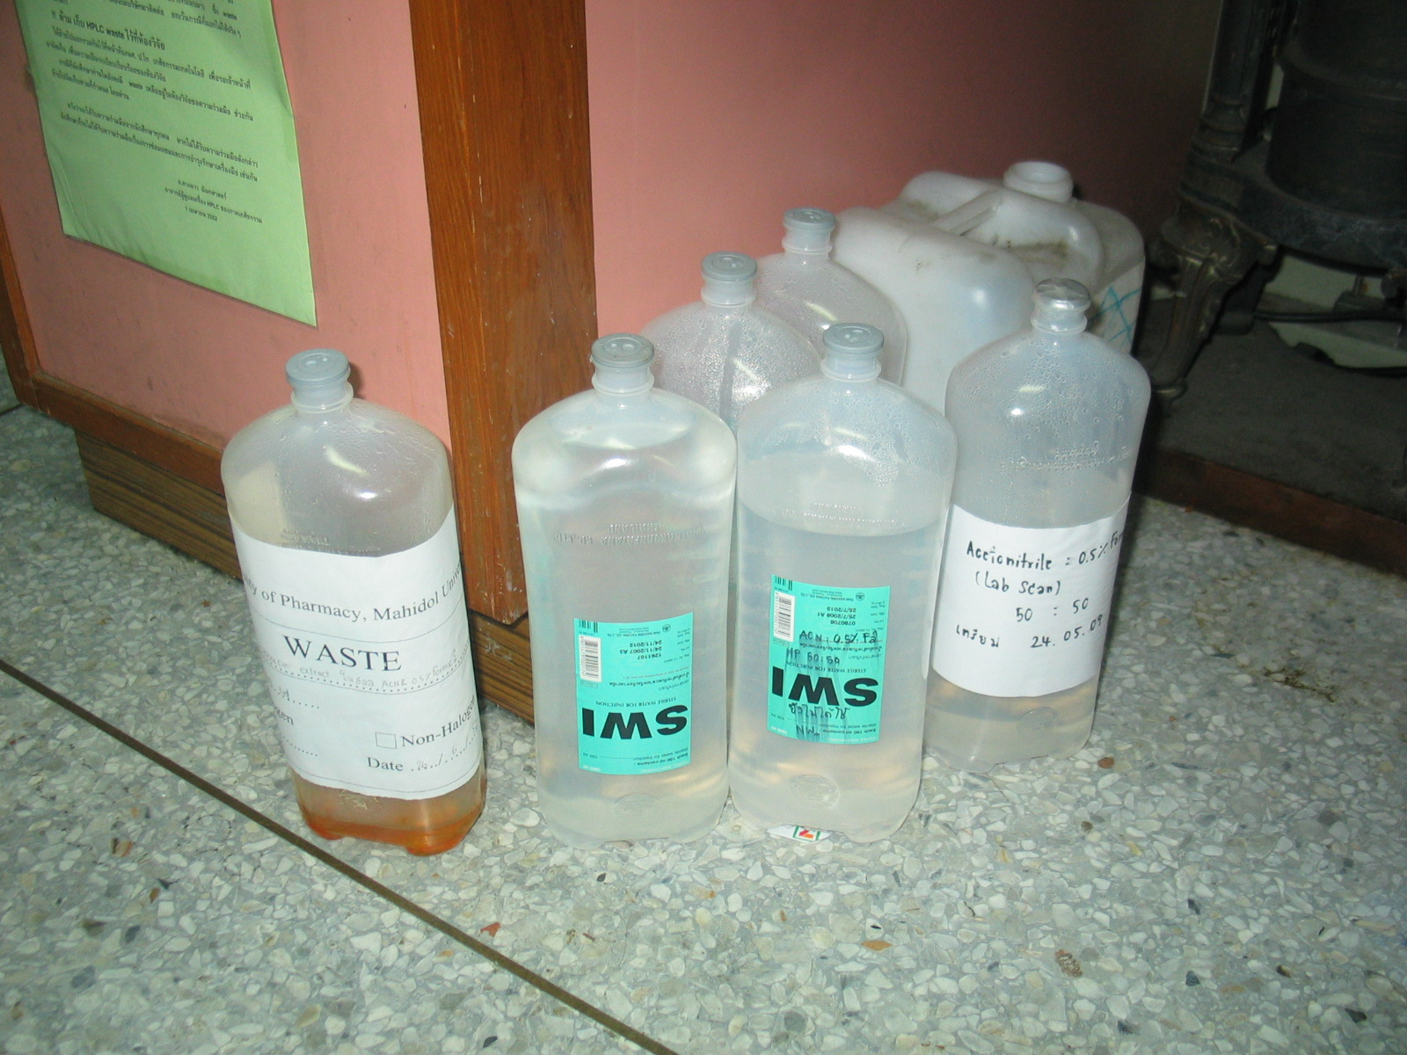
Notes:
2-waste – label – no sterile WFI for waste

Slide 28
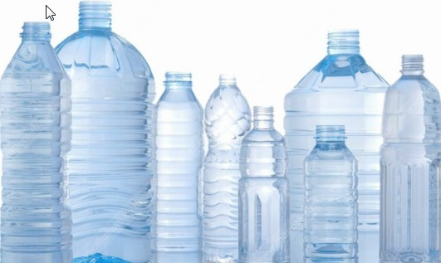

Notes:
No –drinking water to use for waste

Slide 29
Safety Topic – Chemical Hood http://web.mit.edu/cohengroup/safety/hood.pdf
General purpose: prevent exposure to toxic, irritating, or noxious chemical vapors and gases. A face velocity of 100 feet per minute (fpm) provides efficient vapor capture while reducing hood turbulence.

Slide 30
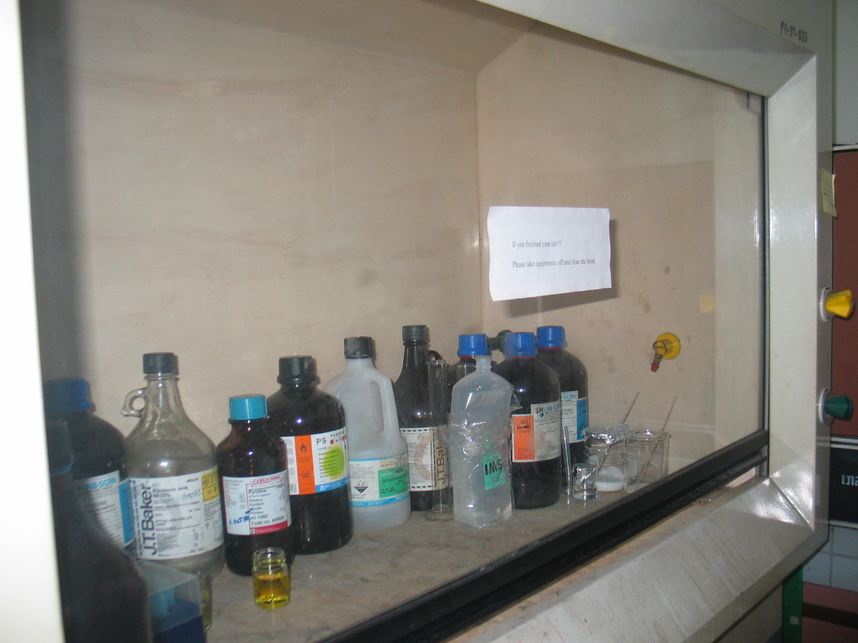
Hood is not used for keeping chemicals.

Slide 31

Protect Your Eyes http://www.sterlingschools.org/shs/stf/cbrown/Chemistry%20Laboratory%20Safety%20Rules.ppt
Appropriate eye protection must be worn at all times!

Slide 32
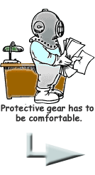
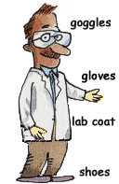
Wear appropriate protective clothing
Your clothing should cover your legs to the knees – shorts are not appropriate for the laboratory
Lab aprons can be used to protect good clothing
Loose clothing should not be worn because it may dip into chemicals or fall into a flame and catch fire

Slide 33

Do not wear protective clothing to public places.

Slide 34

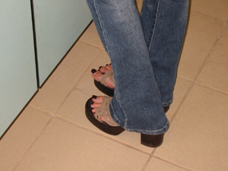

Wear shoes that cover your feet.
Sandals and open-toed shoes do not protect your feet from broken glass that is frequently found in the lab
Also, leather shoes protect your feet from chemical spills – canvas shoes do not.

Slide 35




Do not apply cosmetics, eat, cook or drink in the lab.
These activities are ways by which you can accidentally ingest harmful chemicals

Slide 36

Do not taste any chemical!

Slide 37
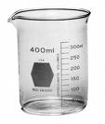
Always ADD Acid to water
acid
water
“Do not spit into acid!” –
a good phrase to remember this rule.

Slide 38
Hold your hand over the label while pouring.

Slide 39
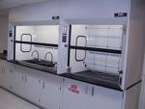

Work with volatile chemicals under a fume hood.

Slide 40

Check glassware for stars or cracks.

Slide 41
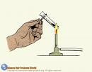
Heat test tubes at an angle, directing the opening oppositely to you and other people in the laboratory.

Slide 42
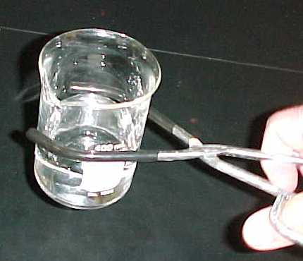

Handle hot glassware with gloves or beaker tongs.

Slide 43


First light the match
THEN
Turn on the gas!

Slide 44
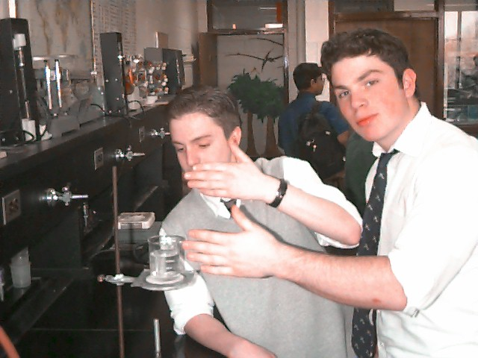
Do not smell any chemicals directly!
If absoluteley necessary to smell, use your hand to fan the vapor to your nose.

Slide 45
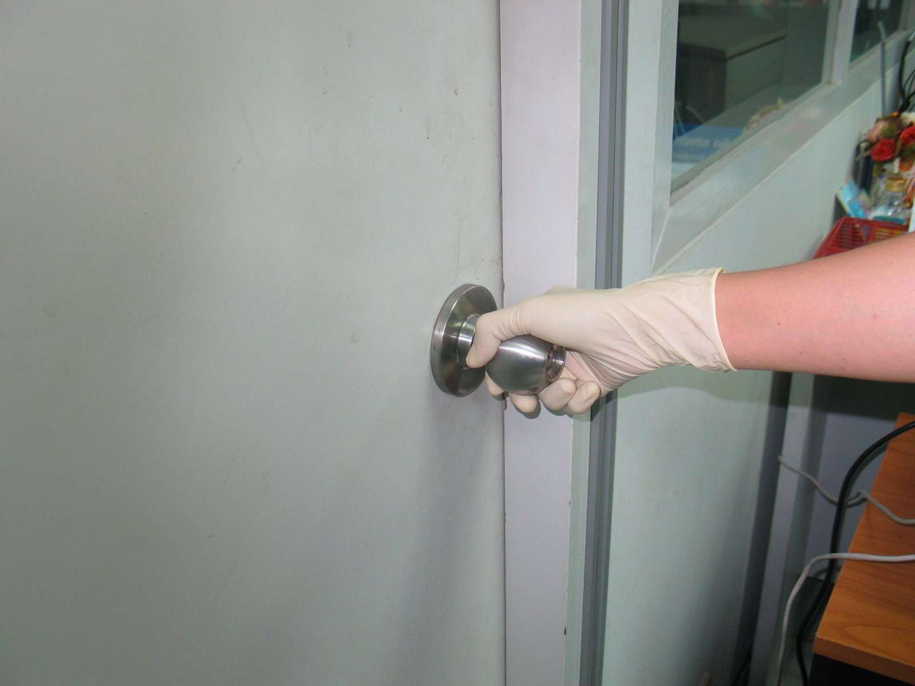
Remove glove before touching any stuff.

Slide 46
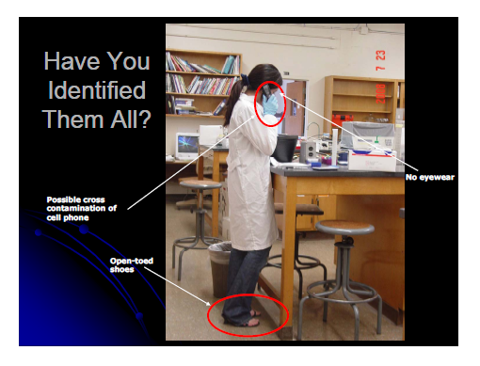

Slide 47

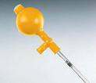
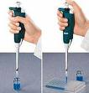
Do not pipet solutions by mouth!
Use a rubber suction bulb or other device to fill a pipet.

Slide 48

Wash your hands with soap and water before leaving.
This rule applies even if you have been wearing gloves!

Slide 49
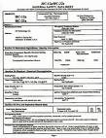
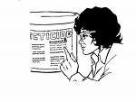
Know the hazards of the materials being used.
Read and reread labels carefully to make sure that you are using the right chemical.
Know how to interpret data from a MSDS.

Slide 50

Tie Back Loose Hair
Dangling hair can fall into the Bunsen burner and catch fire or can fall into a chemical solution
P.S. Burning hair REALLY STINKS !

Slide 51



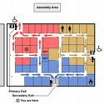
Know the safety equipment
Eye wash fountain
Safety shower
Fire extinguisher
Emergency exits

Slide 52
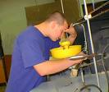
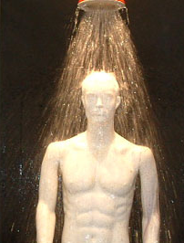
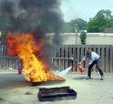

Know how to use the safety equipment
Eye wash Fountain
Safety Shower
Fire extinguisher
Emergency Exit

Slide 53
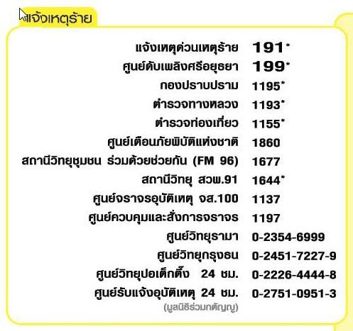
Know how to respond to an emergency

Slide 54

Know how to respond to an emergency

Slide 55

Don’t work alone in the lab
In case of a problem, you may need another person to prevent injury or even save your life!

Slide 56
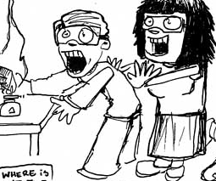
Remember that the lab is a place for serious work!
Careless behavior may endanger yourself and others and will not be tolerated!

Slide 57
Demonstrate safe behavior
Obey all safety instructions.
Clean up spills immediately; IF you know how. If you are uncertain how to clean up a spill or if a large spill occurs, notify persons in accordance to the emergency procedure.

Slide 58
Demonstrate safe behavior
Before leaving the lab:

Slide 59
Demonstrate safe behavior
Before leaving the lab:
  Return equipment and chemicals to their proper places

Slide 60
Demonstrate safe behavior
Before leaving the lab:
  Return equipment and chemicals to their proper places
  Be sure to replace the lids to all containers

Slide 61
Demonstrate safe behavior
Before leaving the lab:
  Return equipment and chemicals to their proper places
  Be sure to replace the lids to all containers
  Clean up your work area
  Turn off the light and air-condition

Slide 62


Slide 63
Chemical Compatibility

Slide 64
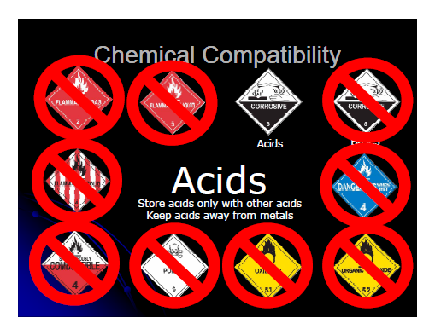

Slide 65
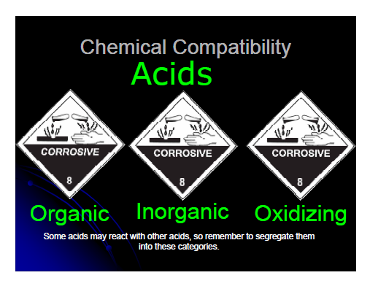

Slide 66
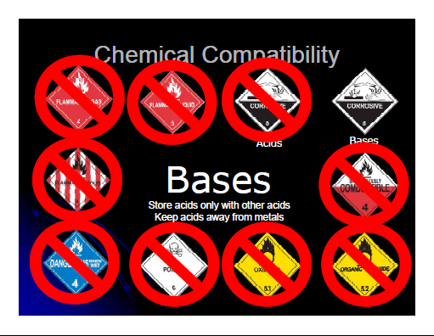

Slide 67


Slide 68


Slide 69


Slide 70


Slide 71


Slide 72


Slide 73




Know how to dispose of waste
Dispose of all waste materials according to your instructional
? ? ? ?

Slide 74

Report any accidents or unsafe conditions immediately!

